Slide 1

Web Development Presentation
Group CS4: Adnan Shah, Sameer Ahmed, Saif Ahmed, Itjihad Ahmed, Obaidullah Rauf and Qays Mahmud

Slide 2
Presentation Roadmap
(Add the roadmap from the presentation)

Slide 3

Purpose of the Project
The purpose of the project is to, as a team to design and create a website with time management tools covering a, b and c.
We also need to create our cover page that describes the group, linking to all of our personal web pages that have been designed by each of the members.

Slide 4
Project Plan
(add the deadlines and milestones here)

Slide 5

Roles
Group Leader: Adnan Shah – the group leader is in charge of everything and will help the group in every way through development, important information, setting up meetings and so on.
Technical Expert: Sameer Ahmed – the technical expert will help too oversee all of the code and ensure that it’s correct, helps in troubleshooting and offering advice.
Developers: Ijtihad Ahmed and Saif Ahmed – the web developers will help in programming and creating the timers, websites, their personal pages and so on.
Designer: Obaidullah Rauf – the designer will create the wireframes, the prototypes and mock-ups of the timers, website pages and much more.
These roles are not permanent and can change during the project or other members may take on multiple of these roles.

Slide 6

Ground Rules
The ground rules that have been established in the group are:
Deadlines need to and must be met by the entire group.
If members of the group are unable to work at particular times or struggling, they need to inform the group leader to avoid progress from being halted.
To get credit, everyone in the group must at least do something but also bearing in mind that you’ll be rewarded for how engaged you were in the project which will be assessed by peers and the professor markers.

Slide 7

Key information to inform our designs of the web portal
The key information and sources we will be using for our web portal, but also the time management tools will be referring to YouTube video tutorials, online information, web development creation websites such as Square Space and other similar prototypes.

Slide 8
List of Functionalities
(Add the functionalities from the HTML presentation you made)

Slide 9
Initial Storyboard
(Add the storyboard that was just made today by Itjihad and Saif)

Slide 10
Initial Wireframes of the design
(Use the wireframes that you created here)

Slide 11
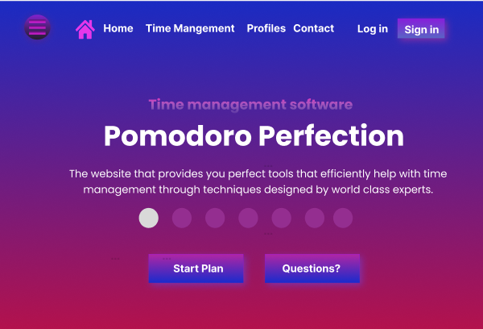
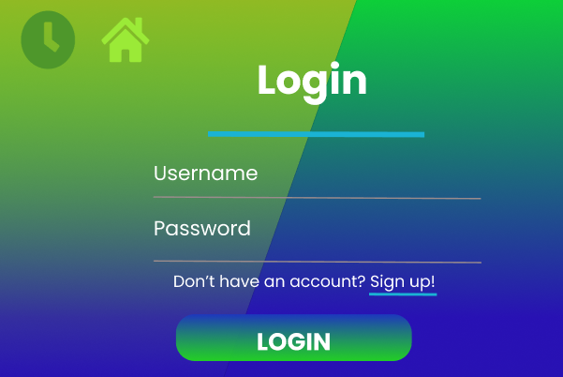
Initial Prototypes of the design

Slide 12
Project plan for group meetings and discussion
(Add the timetable here that Saif made from the presentation)

